Slide 1
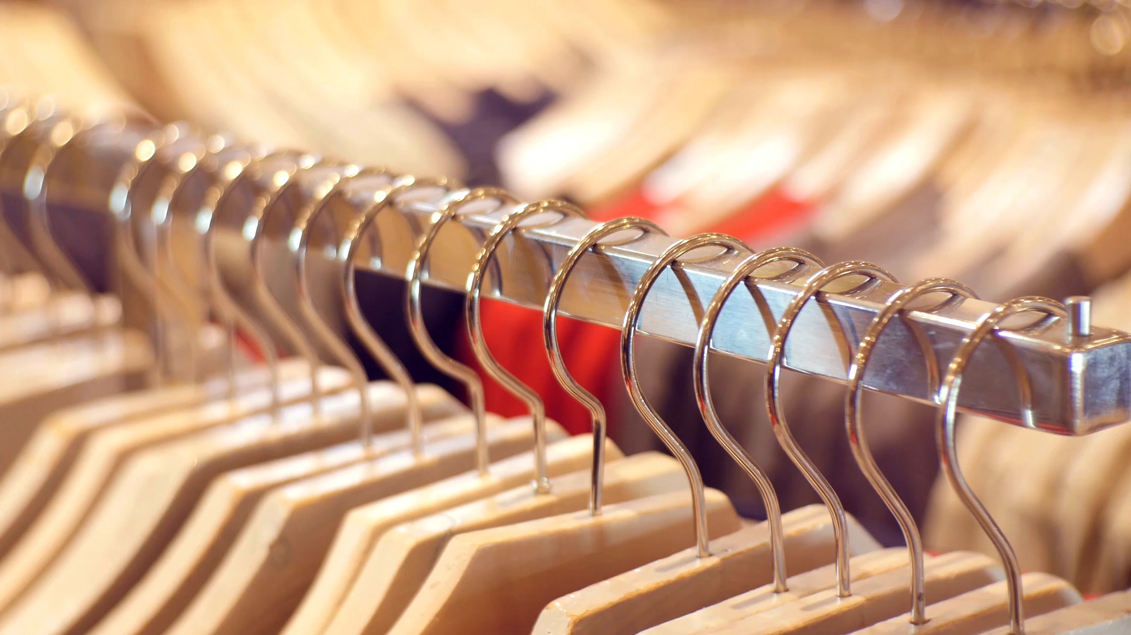
Clothing Feature Extraction and Classification

Slide 2
Content
Introduction
Timeline
Week 1
Week 2
Week 3
Week 4
Week 5
Week 6
Working process
Result

Slide 3

Introduction
Importance of Clothing Classification Algorithm: In an era of rapid growth in the online fashion market, there is great importance in classifying clothing items, understanding customer profiles, developing marketing strategies and optimizing customer-centric experience.
CNN Models for Clothing Classification: CNN models can be used effectively in the field of image classification, as well as to understand and label human clothing. .

Slide 4

Week 1 - Overview of the Fashion Industry
Focusing on the changing trends in the fashion world, we emphasized the importance of clothing classification. We discussed how data analysis and the use of artificial intelligence play a critical role in the correct classification of clothing types. We also evaluated future developments in the fashion industry and the potential of artificial intelligence to speed up clothing sorting processes.

Slide 5
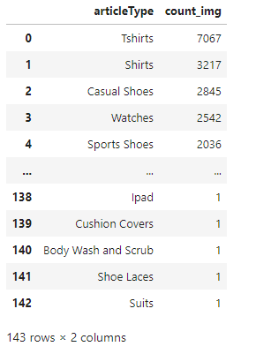
Week 2 - Data Analysis for Clothing Classification
We examined data analysis efforts in the fashion industry and determined our dataset. We also evaluated the data in detail to determine the models used for clothing classification.

Slide 6
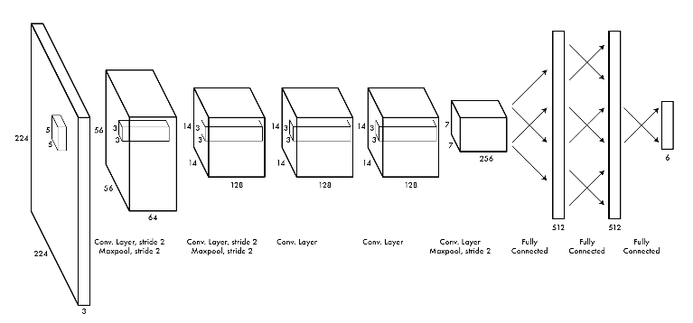
Week 3 - Al Model Selection and Application
We researched pre-trained AI models that we could use to classify fashion products and create various AI models. As a result of this research, we found 3-4 important artificial intelligence models such as VGG16, ResNet, YOLO and Inception within the scope of Convolutional Neural Network (CNN) and Transfer Learning

Slide 7
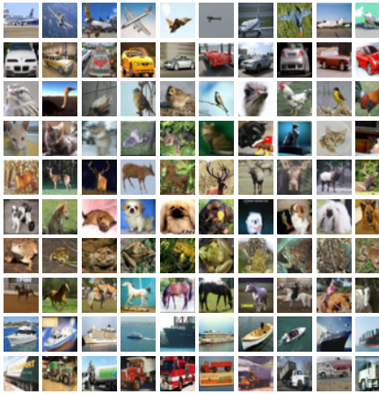
Week 4 - Lightning.ai Application and CIFAR-10 Dataset
We worked on artificial intelligence coding using Lightning.ai libraries and CIFAR-10 data. CIFAR-10 is a dataset of 60,000 color images divided into 10 classes. This dataset is widely used to train and test machine learning and computer vision algorithms. Lightning.ai, on the other hand, offers tools that facilitate machine learning tasks such as data loading, model training and evaluation.

Slide 8
Week 5 - Training and Model Evaluation with fast.ai
With the help of fast.ai, we trained the dataset we will use in our project. The training results we obtained show correct and incorrectly predicted results.

Slide 9
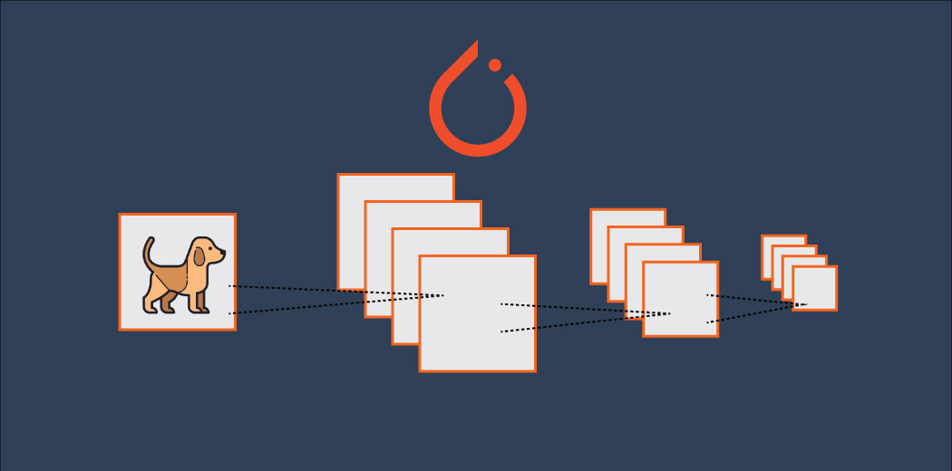
Week 6 - Model Training and Model Evaluation
We trained these 4 models: VGG16- ResNet152- Densenet201 - AlexNet.

Slide 10
Data Preprocessing
'Footwear,’
'Accessories,’
'Apparel,’
'Personal Care,’
'Free Items,’
'Sporting Goods,’
'Home'

Slide 11
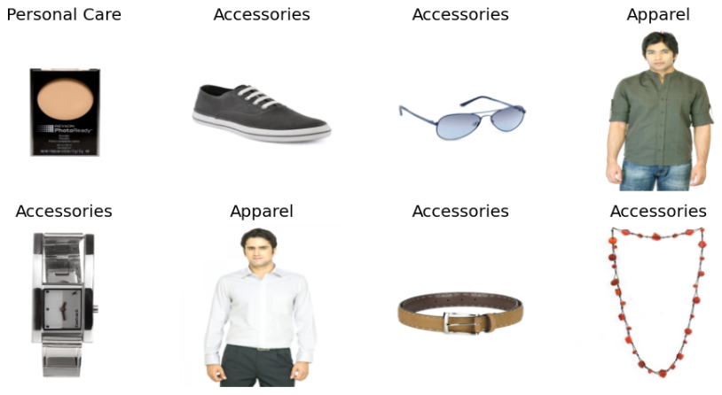
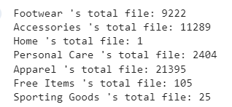

Slide 12
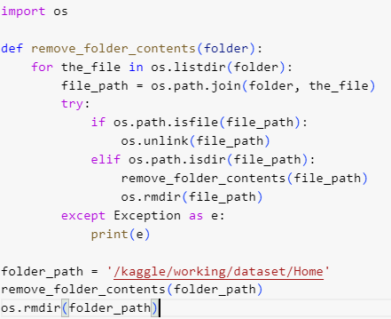
Deleting files in the home category

Slide 13
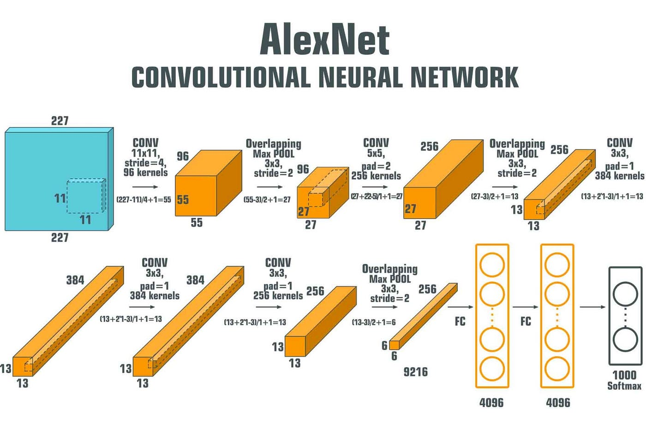
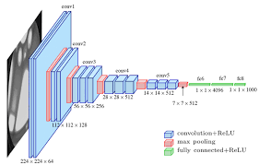
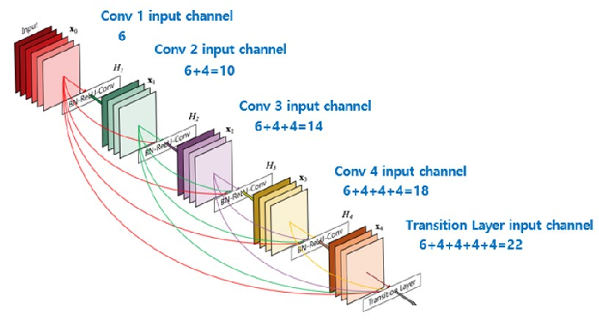
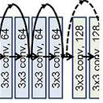
Models Selection and Design
Alexnet
Vgg16
Densenet201
Resnet152

Slide 14
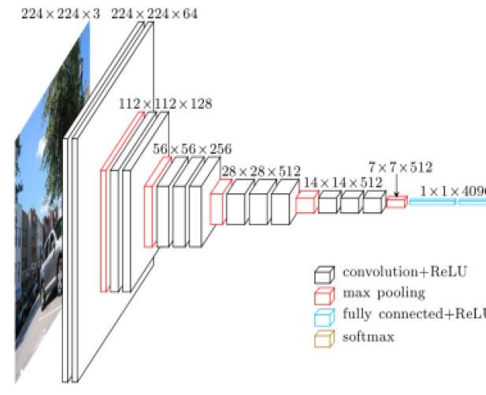
How Works VGG16?

Slide 15
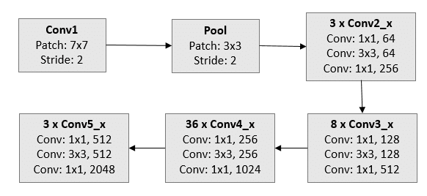
How Works Resnet 152?

Slide 16
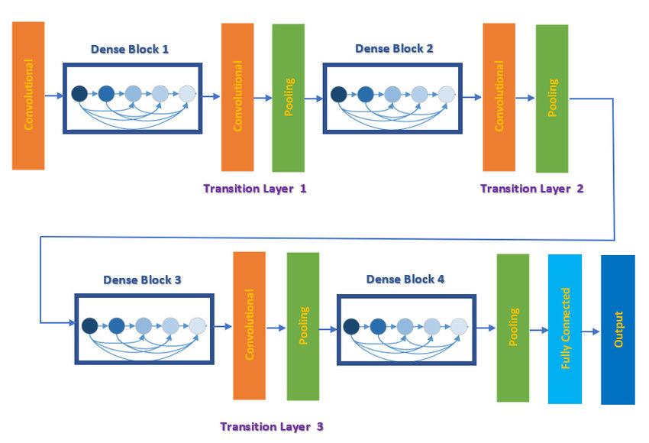
Densenet201

Slide 17
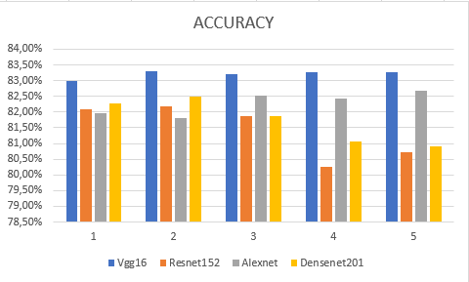
Result

Slide 18
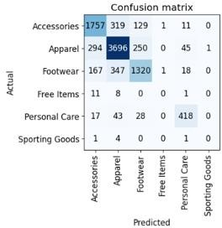
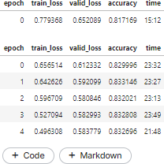
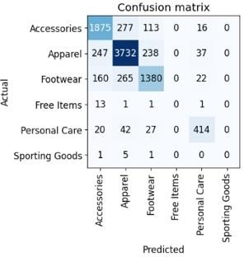
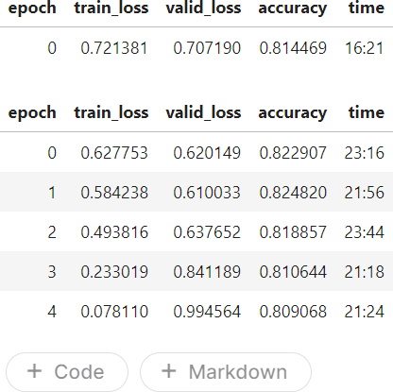
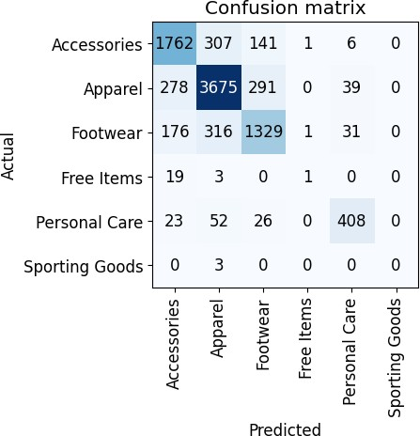
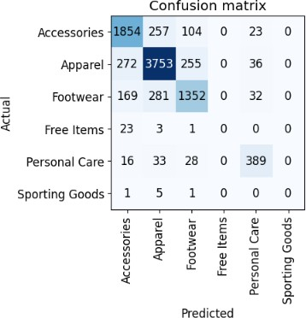
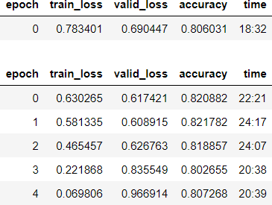
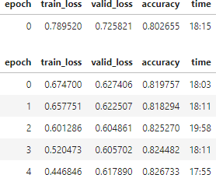
Vgg-16:
Densenet 201:
ResNet 152:
Alexnet:

Slide 19

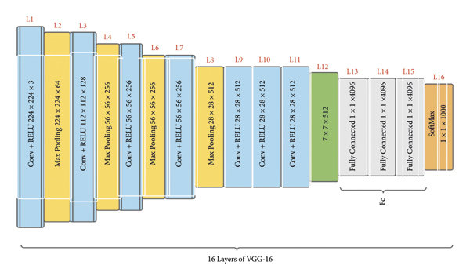
WHY VGG16 ?

Slide 20
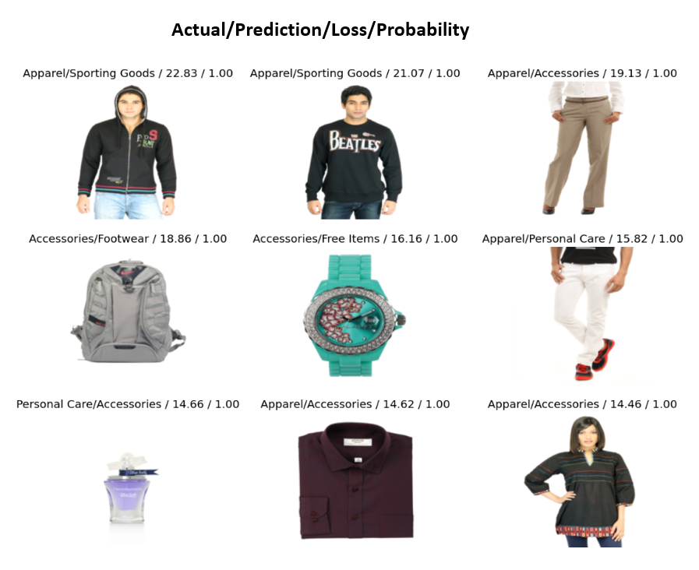

Slide 21
Overfit Analysis
Vgg-16:
In the table, training loss (train_loss) decreases over time, while accuracy (accuracy) increases. This shows that the model is starting to perform well on the training dataset. However, as the validity loss (valid_loss) becomes larger than the training loss, it becomes clear that the model does not perform well on the test dataset.
To prevent overfitting, the following precautions can be taken:
The complexity of the model can be reduced. A less complex model is less likely to learn noise and random variations in the training data set.
Regularization is available. Regularization is a technique that helps reduce the complexity of the model.

Slide 22

Thanks For Listening

